Slide 1
Artificial Neural Networks
Jen-Ing Hwang
Department of Computer Science and
Information Engineering
Fu Jen Catholic University

Slide 2
Outline
Network Architectures
Backpropagation Algorithm
Remarks on Backpropagation

Slide 3
Network Architectures
A Single Neuron
A Layer of Neurons
Multilayer Networks

Slide 4
A Single Neuron
x₀ ≡ 1
x₁
Bias: w₀
Cell body
w₁
Input signals: x_{i}
x₂
w₂
n
f(n)
Output signal: a = f(n)
w_{M}
x_{M}
Weights: w_{i}

Slide 5
A Layer of Neurons (1/3)
Input signals: x_{i}
Output signal: a = f(n)
Input signals: x_{i}
Output signal: a_{j}
x₀ ≡ 1
x₀ ≡ 1
x₁
x₁
a₁
x₂
a
x₂
a₂
x₃
x₃
A Single Neuron
A Layer of 2 Neurons

Slide 6
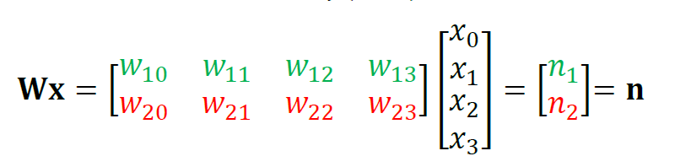
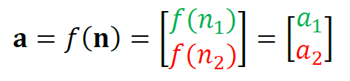
A Layer of Neurons (2/3)
同一層大多是做相同的事情
所以觸發函數是相同的
W10
1是後面的註標
0是前面的註標
Input signals: x_{i}
Output signal: a_{j}
x₀ ≡ 1
x₁
a₁
x₂
a₂
x₃
a₁ = f(n₁ ) = f(w₁₀ x₀ + w₁₁x₁ + w₁₂x₂ + w₁₃x₃ )
a₂ = f(n₂ ) = f(w₂₀ x₀ + w₂₁x₁ + w₂₂x₂ + w₂₃x₃ )

Slide 7
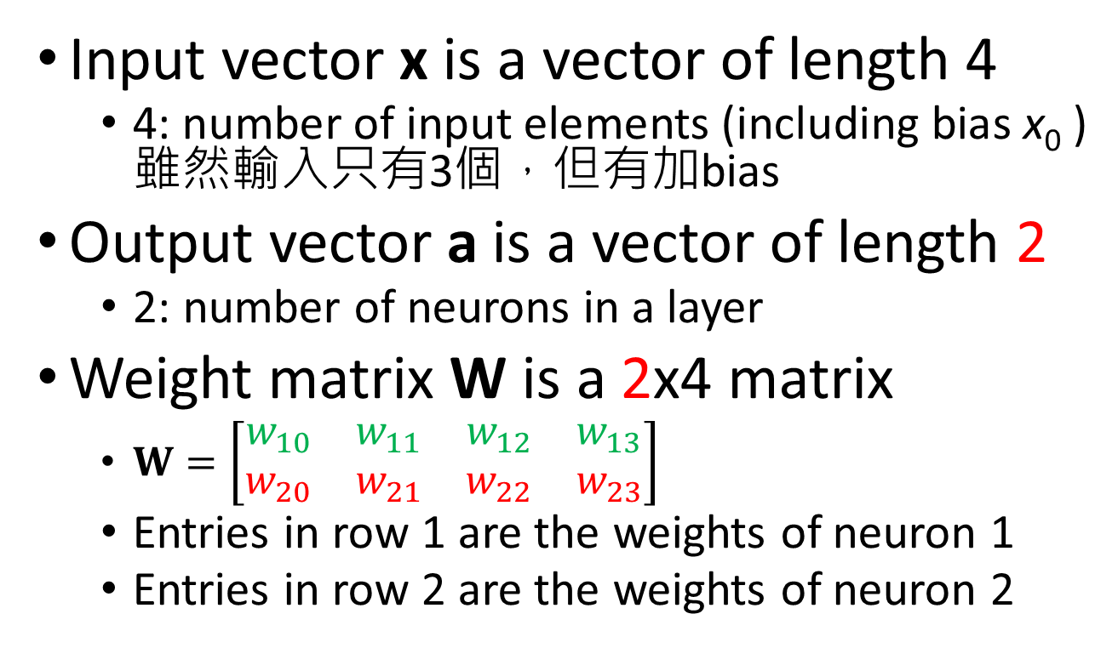
A Layer of Neurons (3/3)
Input vector x is a vector of length 4
4: number of input elements (including bias x₀ )雖然輸入只有3個，但有加bias
Output vector a is a vector of length 2
2: number of neurons in a layer
Weight matrix W is a 2x4 matrix
$W=\left[\begin{matrix}w_{10} & w_{11} & w_{12} & w_{13} \\ w_{20} & w_{21} & w_{22} & w_{23}\end{matrix}\right]$
Entries in row 1 are the weights of neuron 1
Entries in row 2 are the weights of neuron 2
w₂₁
Augmented(擴充) Matrix
表示有加bias
x₁
a₂
先寫後面的再寫前面的

Slide 8
Multilayer Networks (1/4)
A multilayer feedforward network is composed of:
An input layer
One or more hidden layers
An output layer
“Layers”: counted in weight layers
e.g., 1 hidden layer ≡ 2-layer network, 2 hidden layer ≡ 3-layer network
Only hidden and output layers contain neurons
幾層 = 隱藏層 + 輸出層

Slide 9
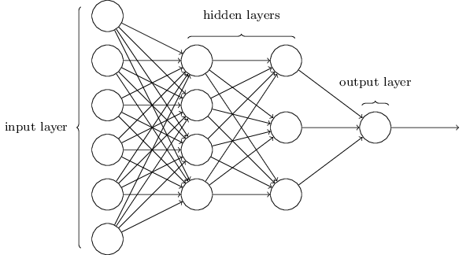
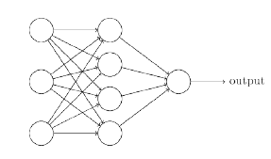
Multilayer Networks (2/4)
為了簡化，所以沒有畫bias
2-layer network
3-layer network
一個hidden layer + 一個output layer
兩個hidden layer + 一個output layer
Figures adapted from Ref. [4]

Slide 10
Multilayer Networks (3/4)
The input layer(輸入層) is called layer 0(第0層)
The outputs of layer k are the inputs of layer (k+1)
Each layer has its weight matrix W, net-input vector n and output vector a
Need some additional notation to distinguish between different layers
Use superscripts to identify the layers

Slide 11
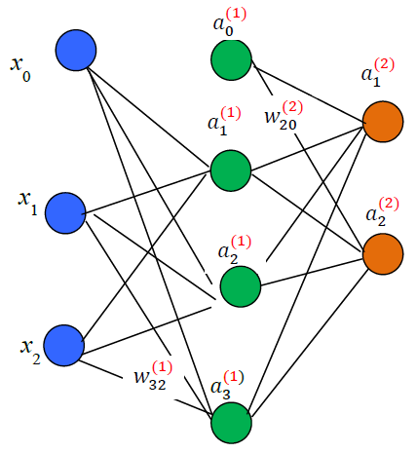
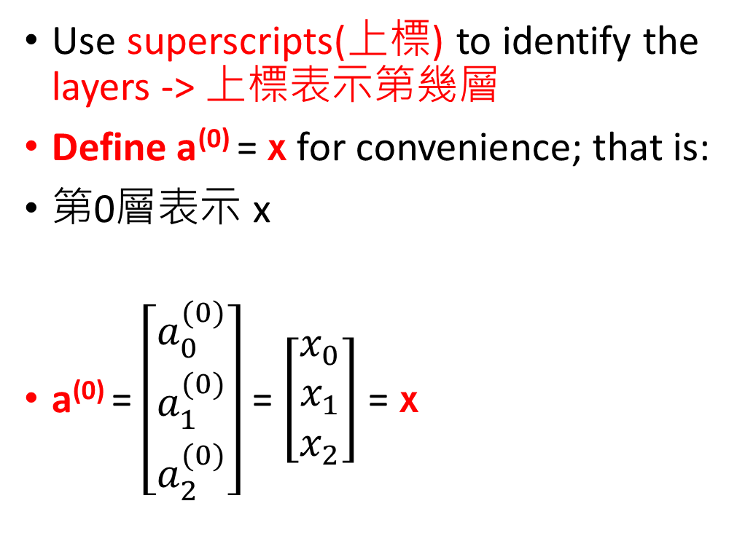
Multilayer Networks (4/4)
上註標說明第幾層
Layer 0
Layer 1
Layer 2
Use superscripts(上標) to identify the layers -> 上標表示第幾層
Define a⁽⁰⁾ = x for convenience; that is:
第0層表示 x
a⁽⁰⁾ = $\left[\begin{matrix}a_{0}^{(0)} \\ a_{1}^{(0)} \\ a_{2}^{(0)}\end{matrix}\right]$ = $\left[\begin{matrix}x_{0} \\ x_{1} \\ x_{2}\end{matrix}\right]$ = x
恆為1
W10
W20
W30

Slide 12
Backpropagation Algorithm 反傳導
Stochastic Gradient Descent: a Single Neuron
Train a Two-Layer Neural Network
Stochastic Backpropagation: Notation
Backpropagation Procedure
在輸送訊息時 ，就會向前前進，把訊息送到大腦，大腦就會去做認知

Slide 13
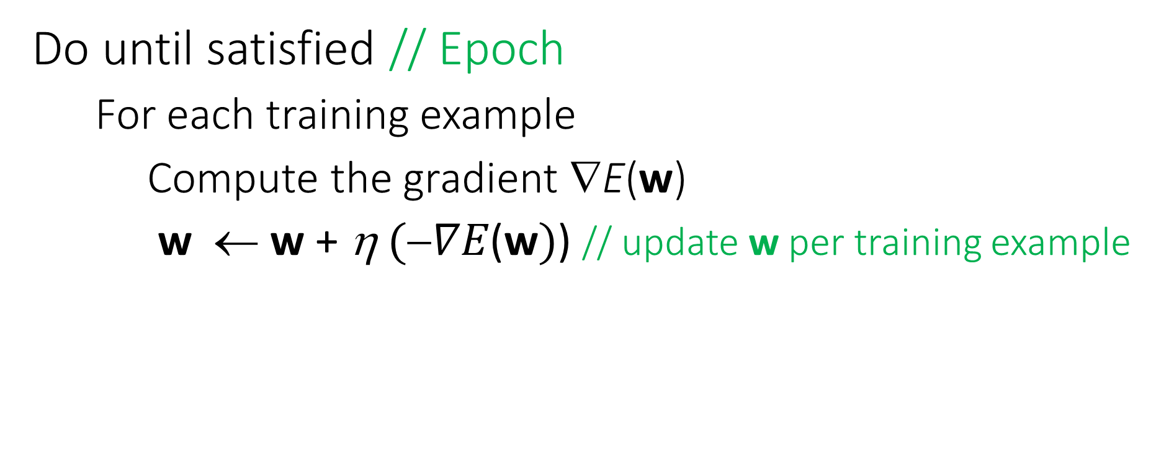
Stochastic (Incremental) Gradient Descent
Do until satisfied // Epoch
For each training example
Compute the gradient ∇E(w)
w ← w + η$(∇E\text{(}\text{w})$) // update w per training example

Slide 14
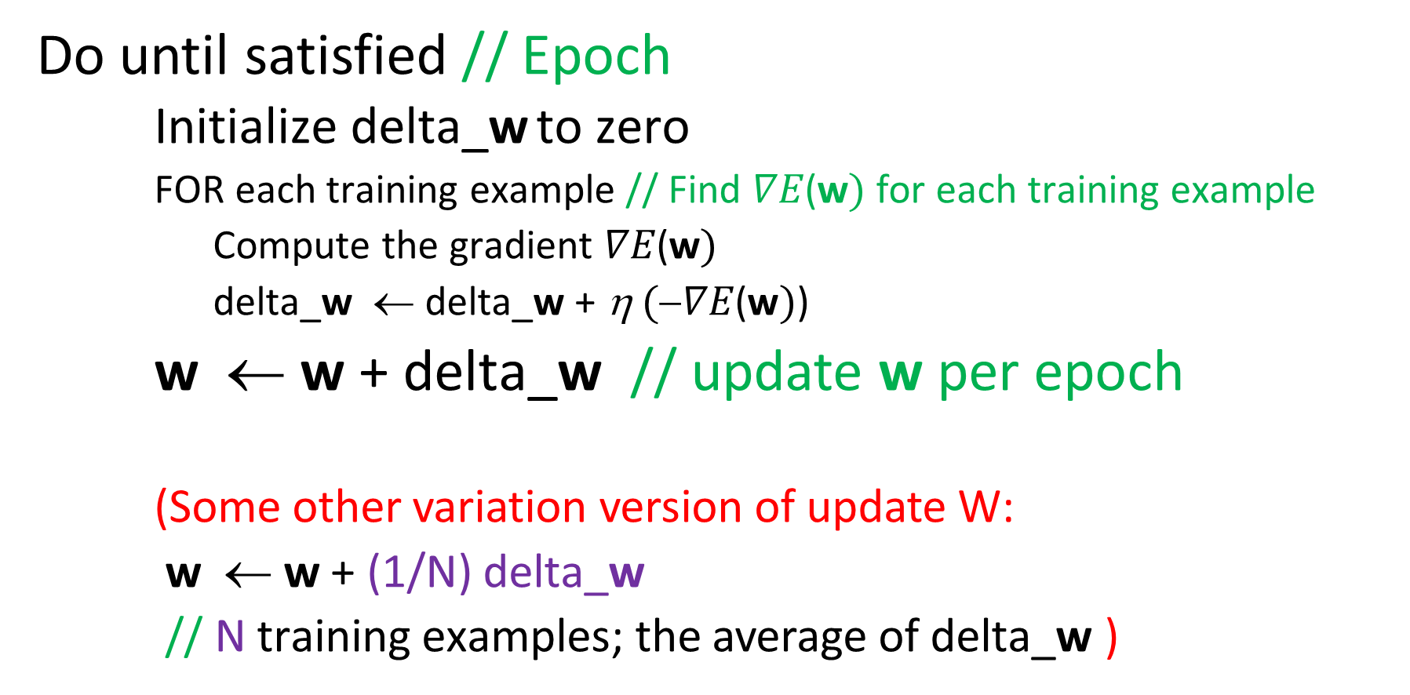
Batch Gradient Descent
Do until satisfied // Epoch
Initialize delta_w to zero
FOR each training example // Find $∇E\text{(}\text{w})$ for each training example
Compute the gradient $∇E\text{(}\text{w})$
delta_w ← delta_w + η$(∇E\text{(}\text{w})$)
w ← w + delta_$\text{w}$ // update w per epoch
(Some other variation version of update W:
w ← w + (1/N) delta_$\text{w}$
// N training examples; the average of delta_$\text{w}$ )

Slide 15
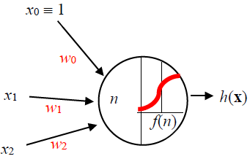
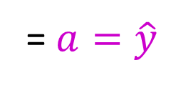
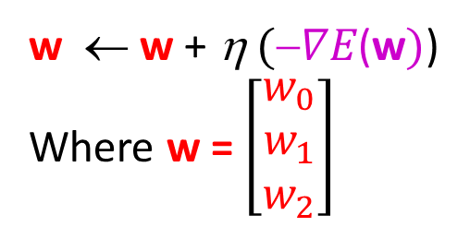
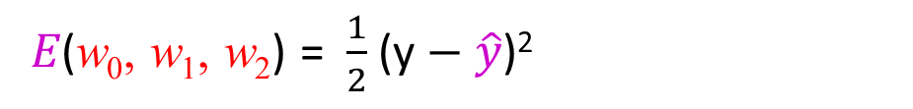
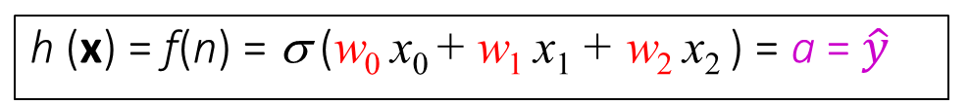
Error Gradient for a Sigmoid Neuron: Half of Squared Error
h (x) = f(n) = σ (w₀ x₀ + w₁ x₁ + w₂ x₂ ) = a = $\hat{y}$
?
≅ y
= $a=\hat{y}$
𝐸(w₀, w₁, w₂) = $\frac{1}{2}$ (y $− \hat{y}$)²
Gradient Descent
w ← w + η$(∇E\text{(}\text{w})$)
Where w = $\left[\begin{matrix}w_{0} \\ w_{1} \\ w_{2}\end{matrix}\right]$

Slide 16
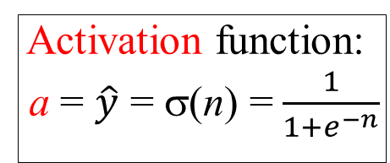
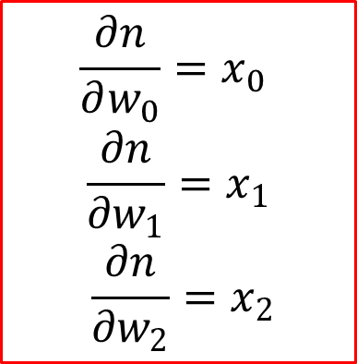

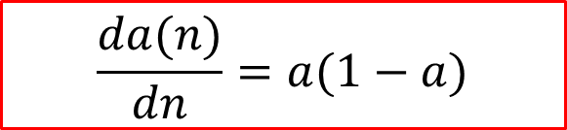
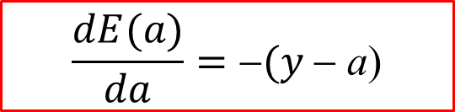
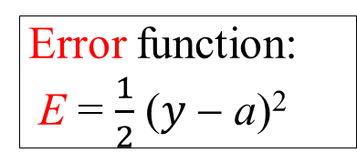
How to find $∇E\text{(}\text{w})$? (1/2)
First, find derivatives of n, a, and E.
Net input:
n = w₀x₀ + w₁x₁ + w₂x₂
Activation function:
a = $\hat{y}$ = σ(n) =$\frac{1}{1+e^{−n}}$
Error function:
E = $\frac{1}{2}$ ($y$− a)²
$$\frac{∂n}{∂w_{0}}=x_{0}$$
$$\frac{∂n}{∂w_{1}}=x_{1}$$
$$\frac{∂n}{∂w_{2}}=x_{2}$$
$$\frac{da(n)}{dn}=a(1−a)$$
$$\frac{dE(a)}{da}=\text{−}(y \text{−} \text{a}\text{)}$$
因為chain rule所以要加負號

Slide 17
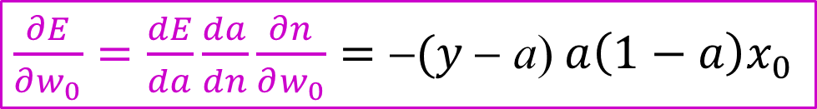




How to find $∇E\text{(}\text{w})$? (2/2)
Next, use the chain rule to find $\frac{∂E}{∂w_{0}}$, $\frac{∂E}{∂w_{1}}$, $\frac{∂E}{∂w_{2}}$:
$\frac{∂E}{∂w_{0}}=\frac{dE}{da}\frac{da}{dn}\frac{∂n}{∂w_{0}}=$ $\text{}(y \text{−} \text{a}\text{)} a\left(1−a\right)x_{0}$
$\frac{∂E}{∂w_{1}}=\frac{dE}{da}\frac{da}{dn}\frac{∂n}{∂w_{1}}=$ $\text{}(y \text{−} \text{a}\text{)} a\left(1−a\right)x_{1}$
$\frac{∂E}{∂w_{2}}=\frac{dE}{da}\frac{da}{dn}\frac{∂n}{∂w_{2}}=$ $\text{}(y \text{−} \text{a}\text{)} a\left(1−a\right)x_{2}$

Slide 18
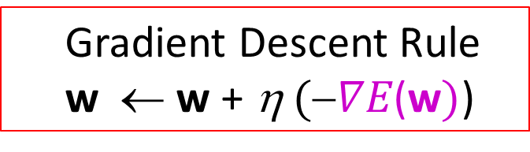
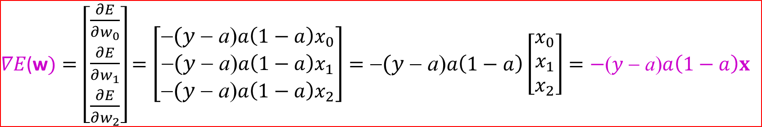
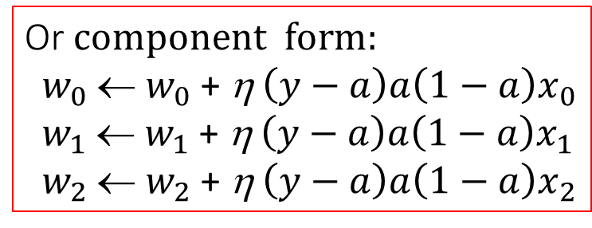
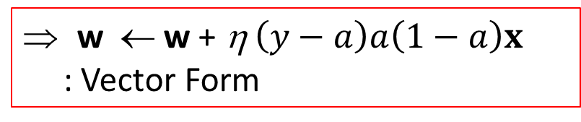
Stochastic Gradient Descent: a Single Neuron
$∇E\text{(}\text{w})=\left[\begin{matrix}\frac{∂E}{∂w_{0}} \\ \frac{∂E}{∂w_{1}} \\ \frac{∂E}{∂w_{2}}\end{matrix}\right]$ $=\left[\begin{matrix}\text{}(y \text{} \text{a}\text{)}a\left(1−a\right)x_{0} \\ \text{}(y \text{} \text{a}\text{)}a\left(1−a\right)x_{1} \\ \text{}(y \text{} \text{a}\text{)}a\left(1−a\right)x_{2}\end{matrix}\right]=\text{}(y \text{} \text{a}\text{)}a\left(1−a\right)\left[\begin{matrix}x_{0} \\ x_{1} \\ x_{2}\end{matrix}\right]$ $=−\text{(}y \text{−} \text{a}\text{)}a\left(1−a\right)x$
Gradient Descent Rule
w ← w + η$(∇E\text{(}\text{w})$)
Or $component form:$
$w_{0}$← $w_{0}$ + η$\left(y−a\right){a\left(1−a\right)x}_{0}$
$w_{1}$← $w_{1}$ + η$\left(y−a\right){a\left(1−a\right)x}_{1}$
$w_{2}$← $w_{2}$ + η$\left(y−a\right){a\left(1−a\right)x}_{2}$
w ← w + η$\left(y−a\right)a\left(1−a\right)x$
: Vector Form

Slide 19
Illustrative Example of Backpropagation Algorithm
Example:
A two-layer neural network
Activation Function: Sigmoid Function
Error Function: Half of Squared Error
Learning Algorithm: Stochastic Gradient Descent (SGD)

Slide 20
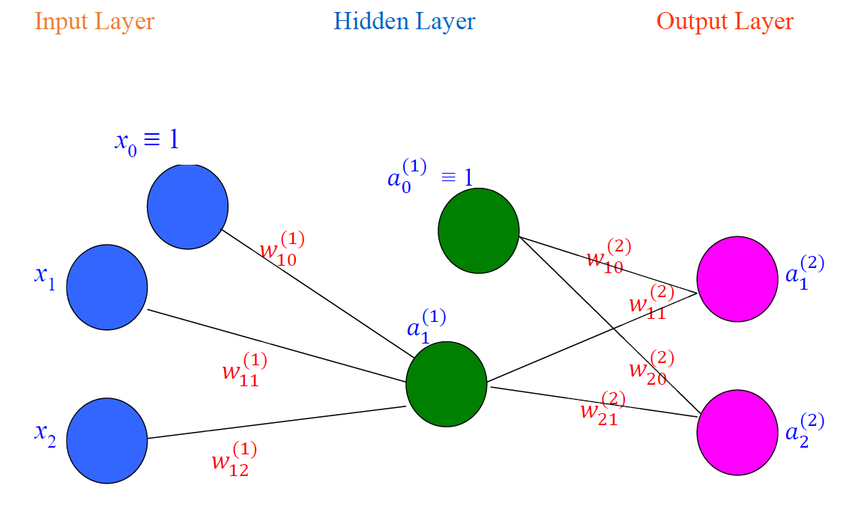
Two-Layer Neural Network: Example

Slide 21
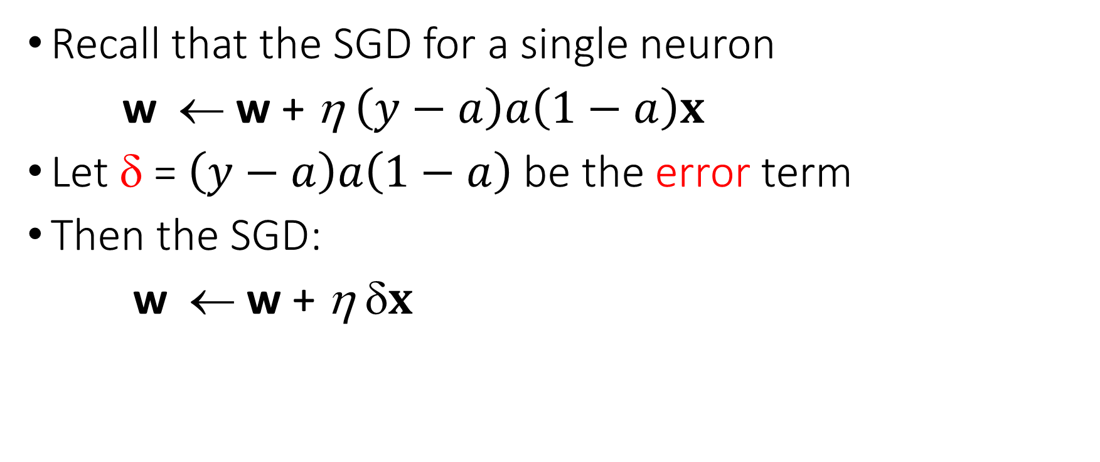
How to Train a Two-Layer Neural Network?
Recall that the SGD for a single neuron
w ← w + η$\left(y−a\right)a\left(1−a\right)x$
Let δ = $\left(y−a\right)a\left(1−a\right)$ be the error term
Then the SGD:
w ← w + η δ$x$

Slide 22
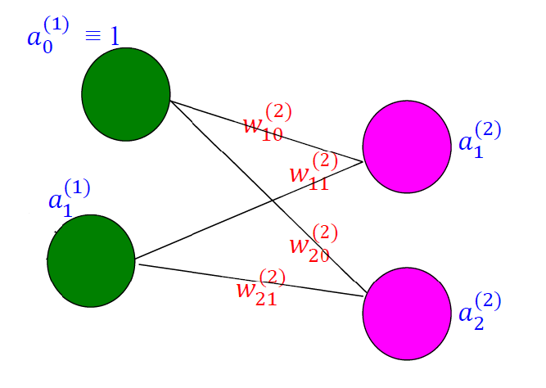

Error Term of the Output Layer
Let $δ_{j}^{(2)}=\left(y_{j}^{(2)} – a_{j}^{(2)}\right)\left[a_{j}^{(2)}\left(1 − a_{j}^{(2)}\right)\right]$, j = 1, 2
Then $w_{ji}^{(2)}←w_{ji}^{(2)}\text{+ }\text{η}δ_{j}^{(2)}a_{i}^{(1)}\text{, }\text{j} \text{= 1, 2}$ and i = 0, 1

Slide 23
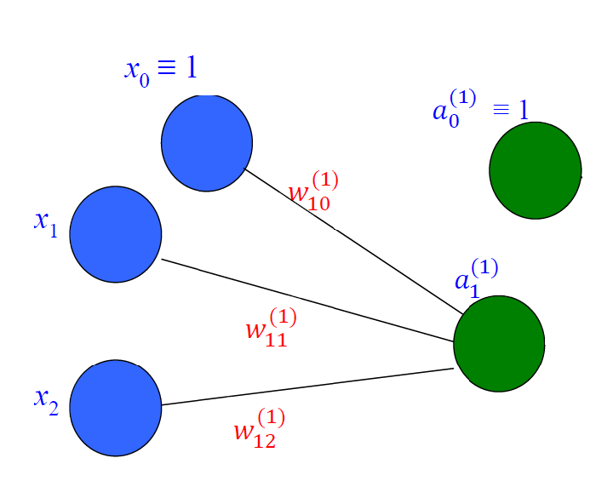

Error Term of the Hidden Layer (1/3)
We can not find $δ_{1}^{(1)}$using: $δ_{1}^{(1)}=\left(y_{1}^{(1)} – a_{1}^{(1)}\right)\left[a_{1}^{(1)}\left(1 − a_{1}^{(1)}\right)\right]$
Because $y_{1}^{(1)}$ is unknown

Slide 24
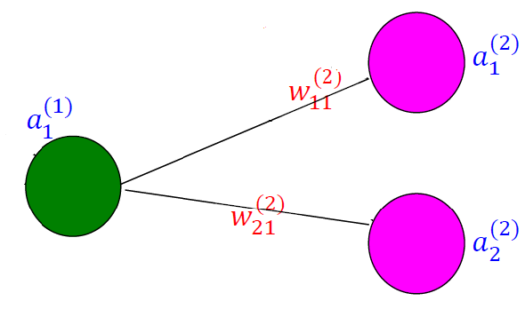

Error Term of the Hidden Layer (2/3)
The value of $δ_{1}^{(1)}$ can be determined by:
$δ_{1}^{(1)}= (w_{11}^{\left(2\right)}δ_{1}^{\left(2\right)} +w_{21}^{(2)}δ_{2}^{\left(2\right)})$ $\left[a_{1}^{\left(1\right)}\left(1−a_{1}^{\left(1\right)}\right)\right]$

Slide 25
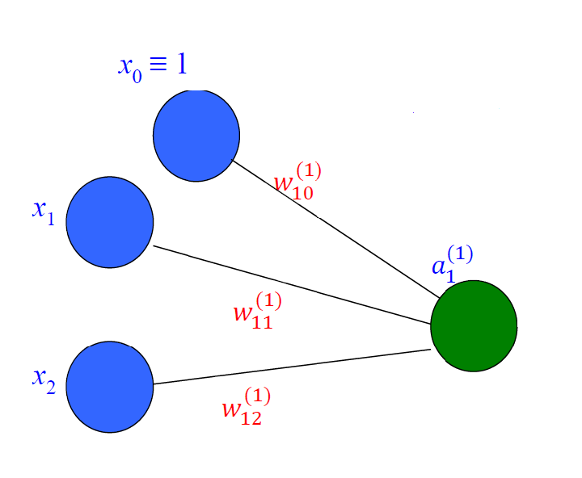

Error Term of the Hidden Layer (3/3)
Let a⁽⁰⁾ = $\left[\begin{matrix}a_{0}^{(0)} \\ a_{1}^{(0)} \\ a_{2}^{(0)}\end{matrix}\right]$ = $\left[\begin{matrix}x_{0} \\ x_{1} \\ x_{2}\end{matrix}\right]$ = x
$w_{ji}^{(1)}←w_{ji}^{(1)}\text{+ }\text{η}δ_{j}^{(1)}a_{i}^{(0)}\text{, }\text{j} \text{= 1}$ and i = 0, 1, 2

Slide 26

Stochastic Backpropagation: Notation (1/4)
(x, y): training example
$x=\left[\begin{matrix}x_{0}≡1 \\ x_{1} \\ x_{2}\end{matrix}\right]$, where x_{1,} and x₂ are input attributes
$y=\left[\begin{matrix}y_{1} \\ y_{2}\end{matrix}\right]$.

Slide 27
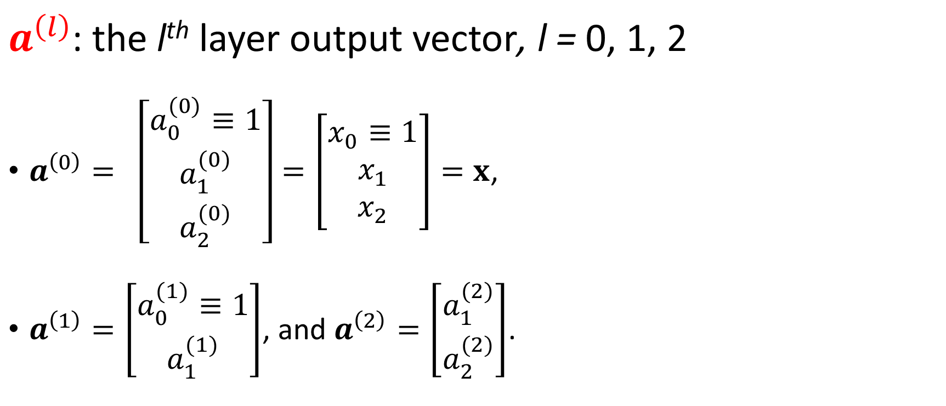
Stochastic Backpropagation: Notation (2/4)
$a^{\left(l\right)}$: the l^{th} layer output vector, l = 0, 1, 2
$a^{\left(0\right)}= \left[\begin{matrix}a_{0}^{(0)}≡1 \\ a_{1}^{(0)} \\ a_{2}^{(0)}\end{matrix}\right]=\left[\begin{matrix}x_{0}≡1 \\ x_{1} \\ x_{2}\end{matrix}\right]=x$,
$a^{\left(1\right)}=\left[\begin{matrix}a_{0}^{(1)}≡1 \\ a_{1}^{(1)}\end{matrix}\right]$, and $a^{\left(2\right)}=\left[\begin{matrix}a_{1}^{(2)} \\ a_{2}^{(2)}\end{matrix}\right]$.
最一開始的輸入

Slide 28
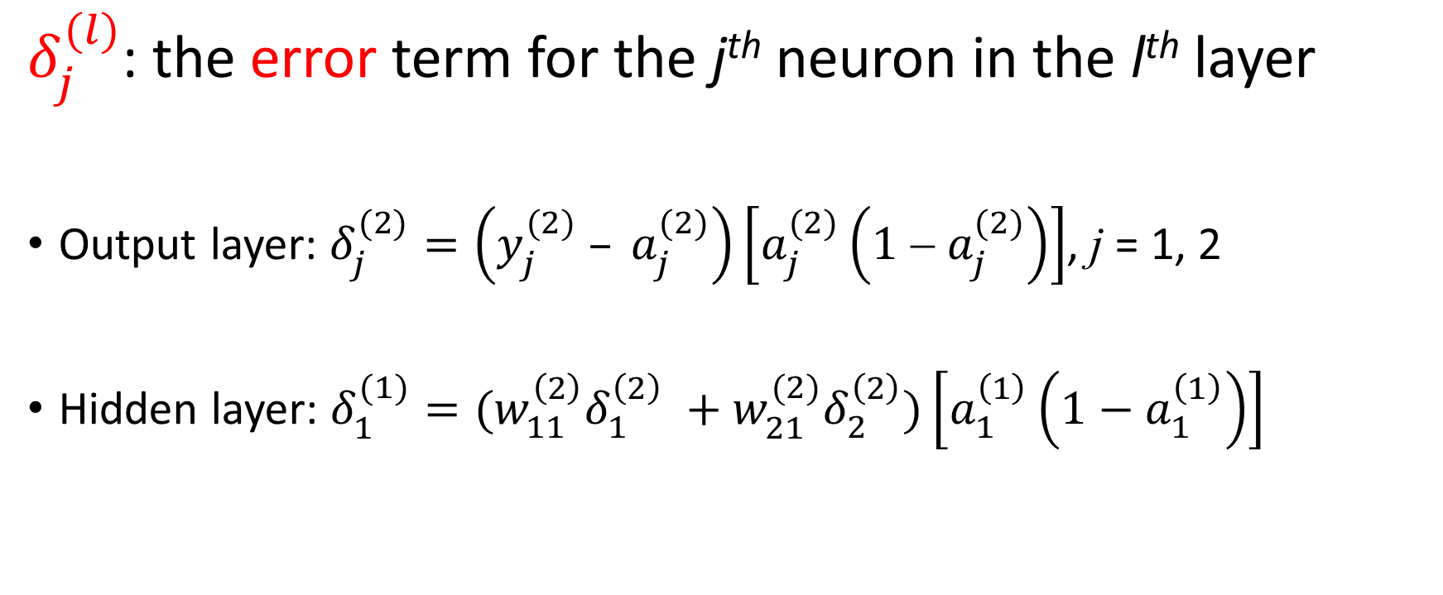
Stochastic Backpropagation: Notation (3/4)
$δ_{j}^{(l)}$: the error term for the j^{th} neuron in the l^{th} layer
Output layer: $δ_{j}^{(2)}=\left(y_{j}^{(2)} – a_{j}^{(2)}\right)\left[a_{j}^{(2)}\left(1 − a_{j}^{(2)}\right)\right]$, j = 1, 2
Hidden layer: $δ_{1}^{(1)}=(w_{11}^{\left(2\right)}δ_{1}^{\left(2\right)} +w_{21}^{(2)}δ_{2}^{\left(2\right)})\left[a_{1}^{\left(1\right)}\left(1−a_{1}^{\left(1\right)}\right)\right]$

Slide 29
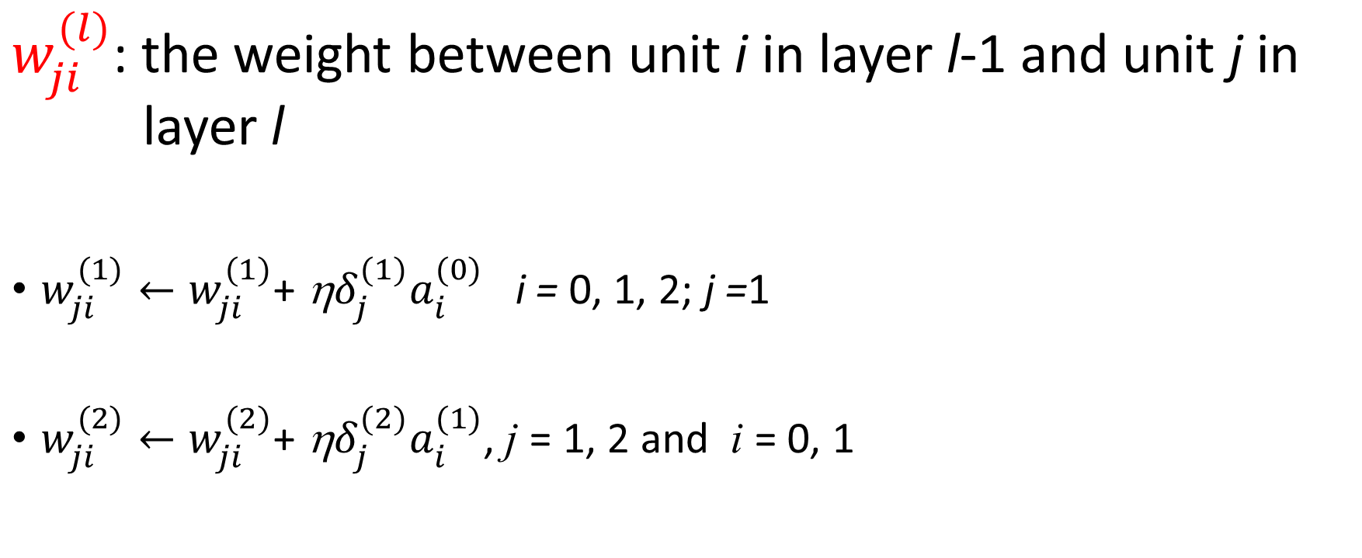
Stochastic Backpropagation: Notation (4/4)
$w_{ji}^{(l)}$: the weight between unit i in layer l-1 and unit j in layer l
$w_{ji}^{(1)}←w_{ji}^{(1)}\text{+ }\text{η}δ_{j}^{(1)}a_{i}^{(0)}$ i = 0, 1, 2; j =1
$w_{ji}^{(2)}←w_{ji}^{(2)}\text{+ }\text{η}δ_{j}^{(2)}a_{i}^{(1)}\text{, }\text{j} \text{= 1, 2}$ and i = 0, 1

Slide 30
Stochastic Backpropagation (1/3)
// Build a two-layer neural network
// Use sigmoid neurons in the hidden layer and the output layer
// For each neuron in the output layer,
// use Half of Squared Error as the loss function

Slide 31
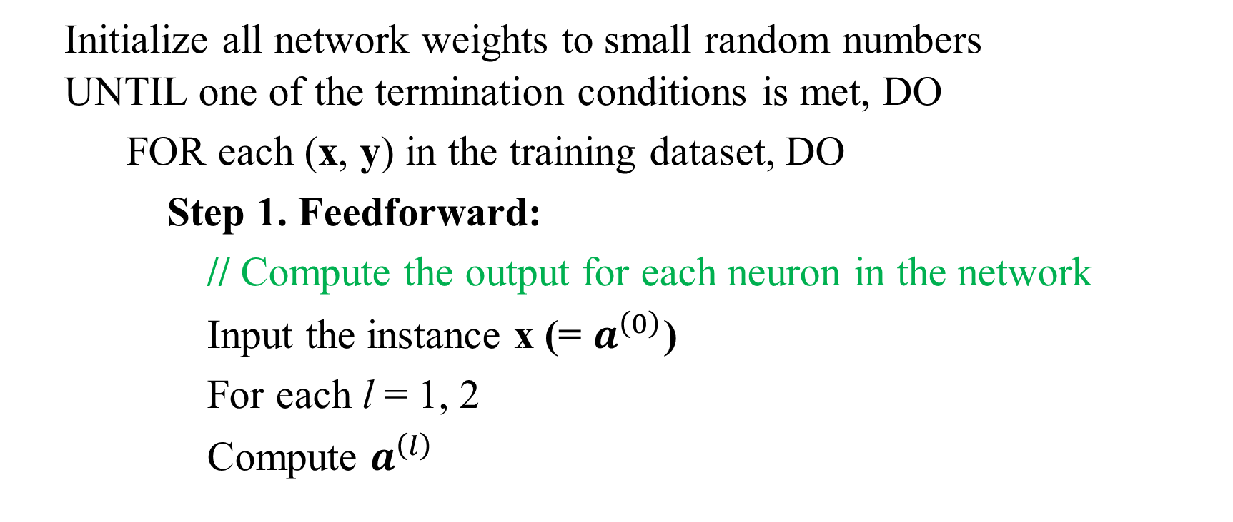
Stochastic Backpropagation (2/3)
Initialize all network weights to small random numbers
UNTIL one of the termination conditions is met, DO
FOR each (x, y) in the training dataset, DO
Step 1. Feedforward:
// Compute the output for each neuron in the network
Input the instance x (= $a^{\left(0\right)}$)
For each l = 1, 2
Compute $a^{\left(l\right)}$

Slide 32
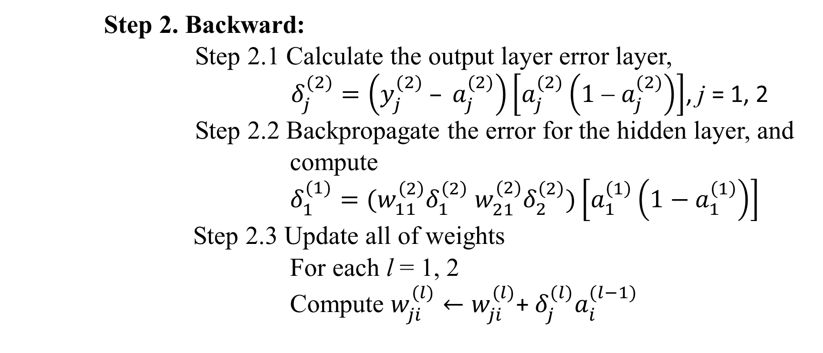
Stochastic Backpropagation (3/3)
Step 2. Backward:
Step 2.1 Calculate the output layer error layer,
$δ_{j}^{(2)}=\left(y_{j}^{(2)} – a_{j}^{(2)}\right)\left[a_{j}^{(2)}\left(1 − a_{j}^{(2)}\right)\right]$, j = 1, 2
Step 2.2 Backpropagate the error for the hidden layer, and
compute
$δ_{1}^{(1)}=(w_{11}^{\left(2\right)}δ_{1}^{\left(2\right)} w_{21}^{(2)}δ_{2}^{\left(2\right)})\left[a_{1}^{\left(1\right)}\left(1−a_{1}^{\left(1\right)}\right)\right]$
Step 2.3 Update all of weights
For each l = 1, 2
Compute $w_{ji}^{(l)}←w_{ji}^{(l)}\text{+} δ_{j}^{(l)}a_{i}^{(l−1)}$

Slide 33
Remarks on Backpropagation
Convergence of Backpropagation
Overfitting
Error functions
Hidden Layer Representations

Slide 34
Convergence of Backpropagation
Note that gradient descent may converge to some local minimum.
Adding momentum may help to avoid some local minima.
Stochastic gradient descent or mini-batch gradient descent may also help to avoid some local minima.
Train multiple networks with different initial weights and learning rates

Slide 35
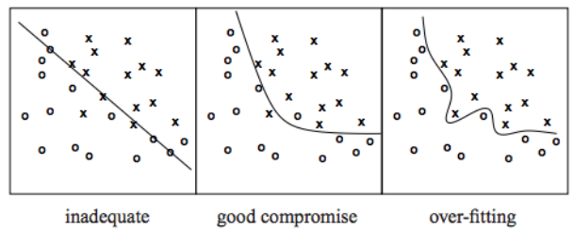
Overfitting
Definition of Overfitting
h’ worse than h on D_{train}, better on D_{test}
Learned hypothesis h may fit the training data very well, even outliers (noise) but fail to generalize to new examples (test data)

Slide 36
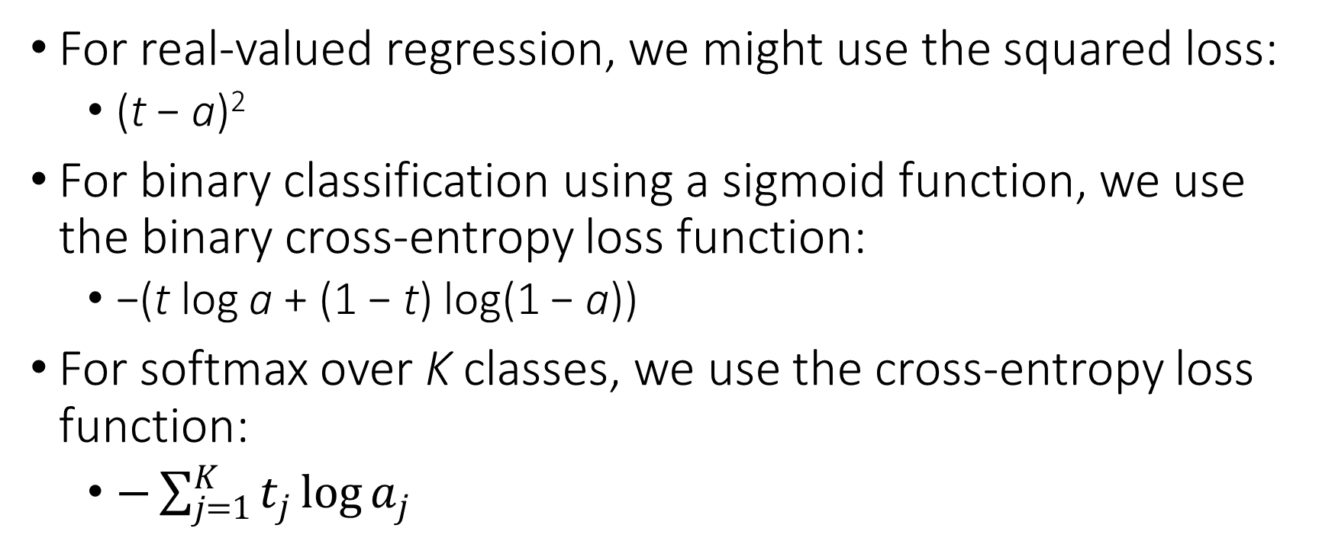
Error functions
For real-valued regression, we might use the squared loss:
(t − a)²
For binary classification using a sigmoid function, we use the binary cross-entropy loss function:
−(t log a + (1 − t) log(1 − a))
For softmax over K classes, we use the cross-entropy loss function:
$−\sum_{j=1}^{K}{t_{j}\log{a_{j}}}$

Slide 37
Hidden Layer Representation
Hidden Units and Feature Extraction
Training procedure: hidden unit representations that minimize error E
Sometimes backpropagation will define new hidden features that are not explicit in the input representation, but which capture properties of the input instances that are most relevant to learning the target function
Hidden units express newly constructed features

Slide 38
References
[1] Neural Network Design (2nd Edition), Martin T Hagan , Howard B Demuth , Mark H Beale , and Orlando De Jesús, Martin Hagan, 2014.
[2] Pattern Recognition and Machine Learning, Christopher Bishop, Springer-Verlag New York, 2006.
[3] Machine Learning, Tom M. Mitchell, McGraw-Hill, 1997.
[4] Neural Networks and Deep Learning, Michael Nielson, https://neuralnetworksanddeeplearning.com

